Slide 1
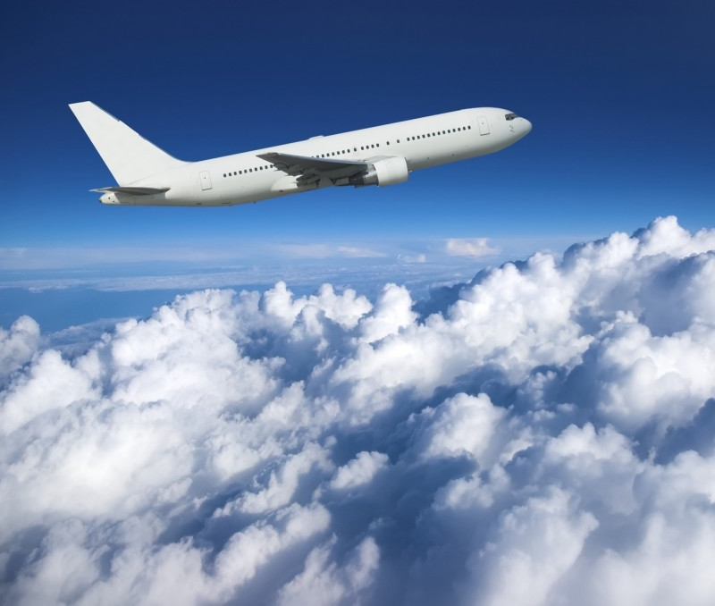
Airline Safety
Jingru Zhang
DSC 640
Executive Summary

Slide 2
Current States
Recent unfortunate airline crashes
Biased news from the media
Airline safety is questioned

Slide 3
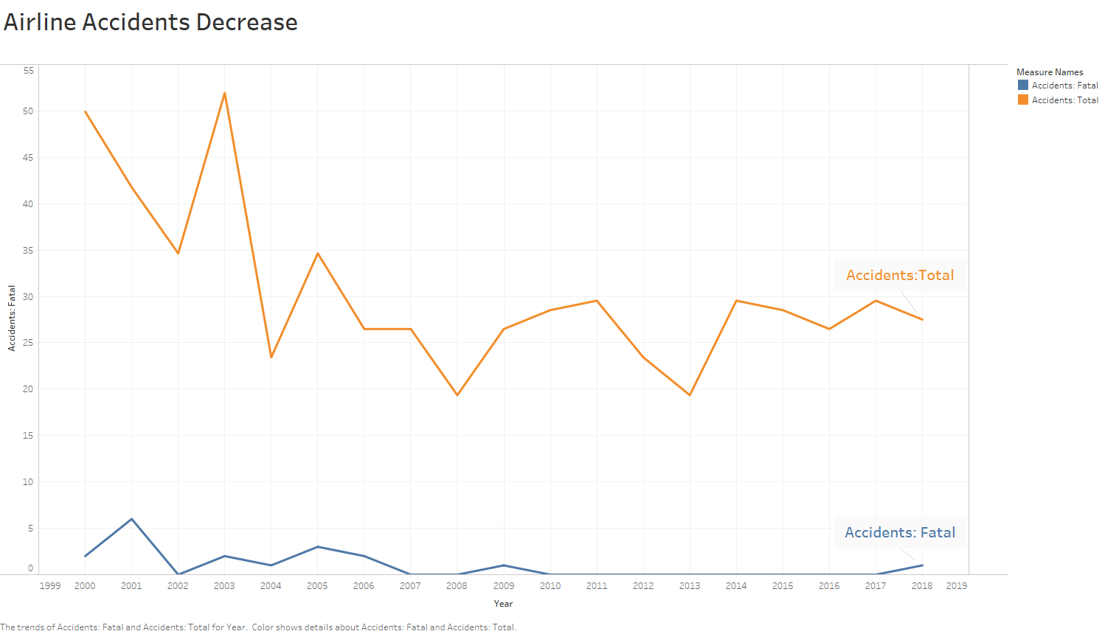
Airline Accidents Decrease in United States (2000-2018)

Slide 4
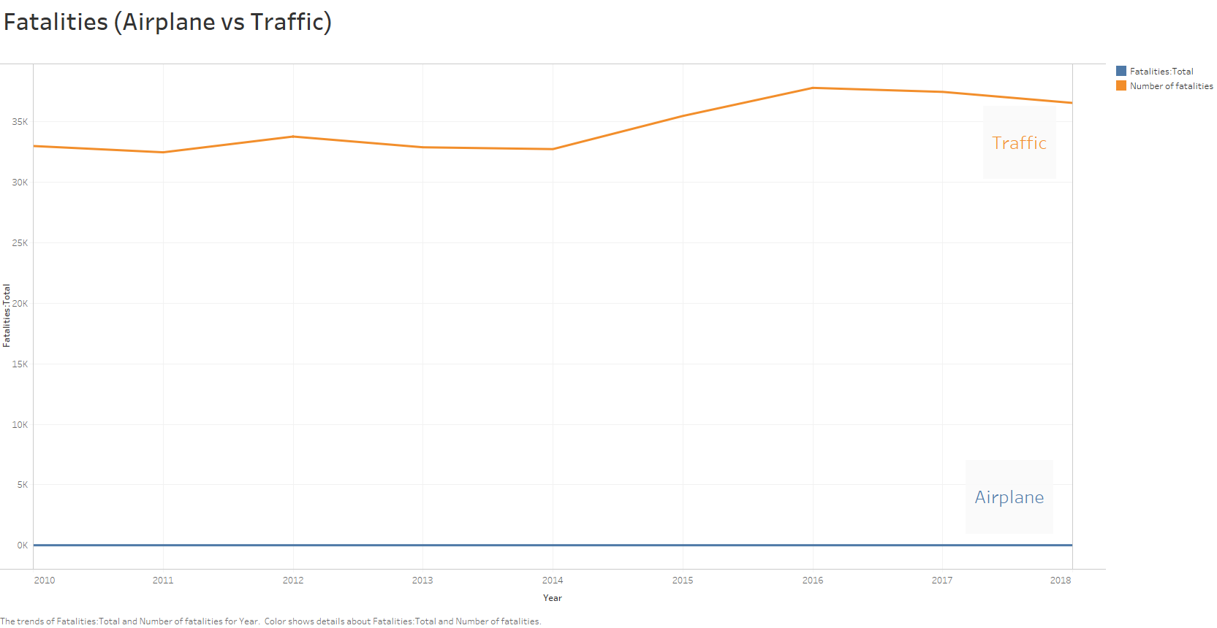
Fatalities in United States (2010-2018)

Slide 5
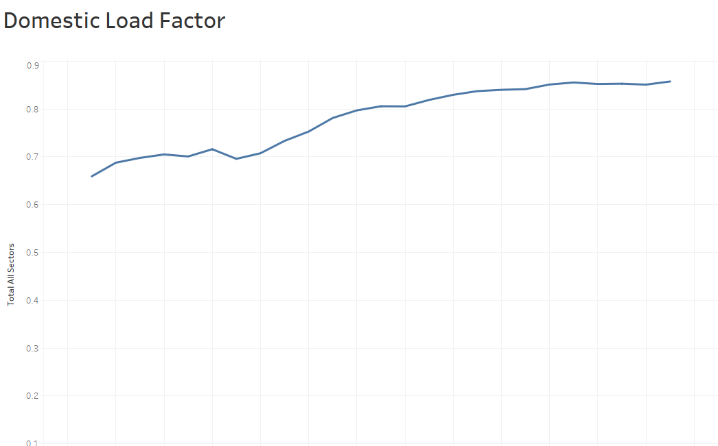
Increase in Aircraft Passengers

Slide 6
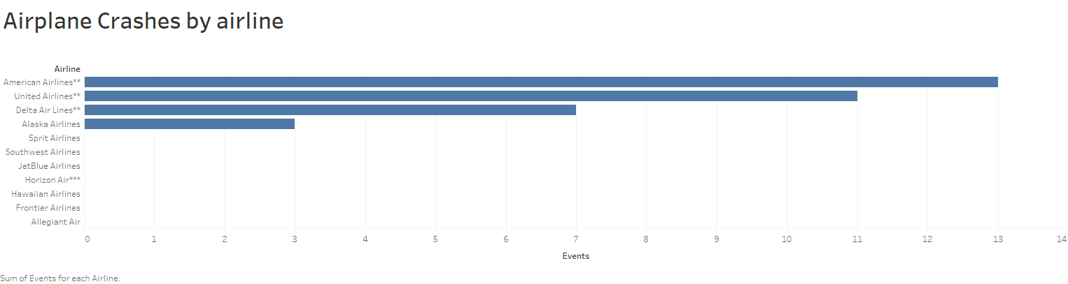
Airplane Crashes by airline

Slide 7
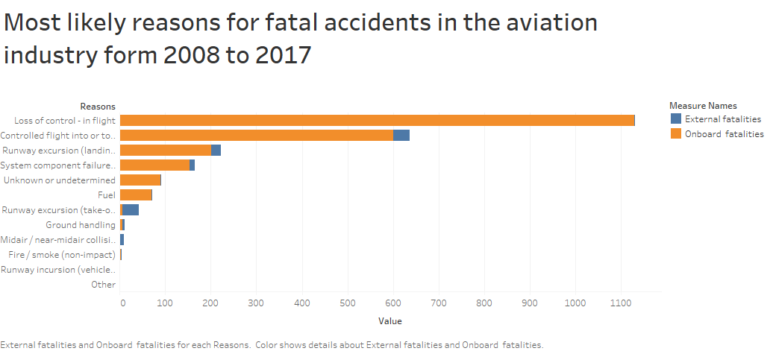
Reasons

Slide 8
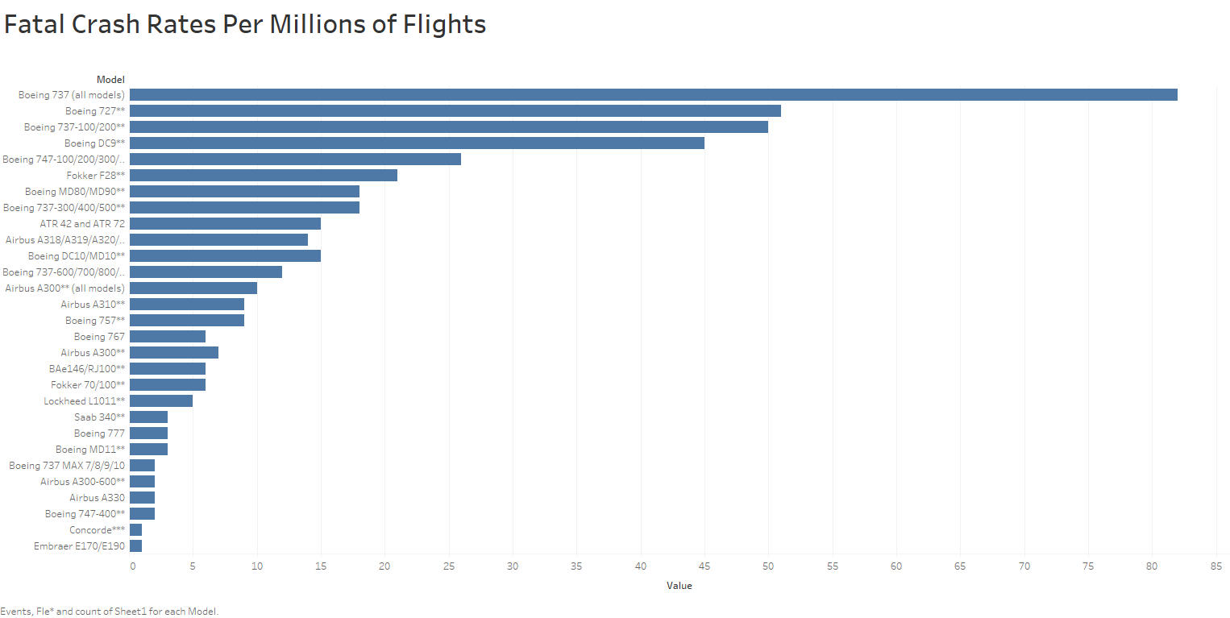

Slide 9
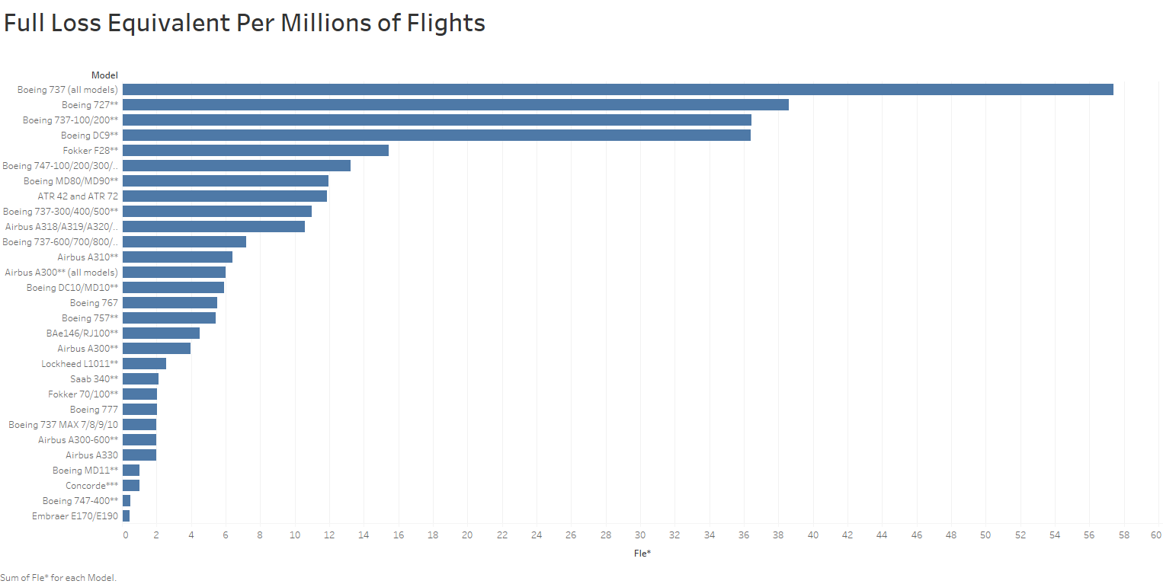

Slide 10

Findings
Compared to some other airlines, our country’s airlines are not safest.
The biggest reason for fatal accidents is loss of control in flight.
Carry out regular inspections and even stop flying models with high accident rates

Slide 11

Data References
AirSafe
http://www.airsafe.com/airline.htm
Statista
https://www.statista.com/statistics/1093239/most-likely-reasons-fatal-accidents-aviation-industry-fatalities/
https://www.statista.com/statistics/191521/traffic-related-fatalities-in-the-united-states-since-1975/
Airlines for America
https://www.airlines.org/dataset/annual-results-u-s-airlines-2/#
https://www.airlines.org/dataset/safety-record-of-u-s-air-carriers/#
Airline data project
http://web.mit.edu/airlinedata/www/Traffic&Capacity.html

